Slide 1
Node Resolution and Relation Classification
FILIP ILIEVSKI;
Hanzhi Zhang;

Slide 2
Background
Most CSKG nodes are lexical (e.g., “hit”)
we do have disambiguated nodes in WordNet
Q1: Can we disambiguate the lexical nodes to WordNet?

Slide 3
Background
Most CSKG nodes are lexical (e.g., “hit”)
we do have disambiguated nodes in WordNet
Q1: Can we disambiguate the lexical nodes to WordNet?
Many relations are underspecified (e.g., HasProperty)
WebChild provides us with specific property relations
Q2: Can we specify the property relations as in WebChild?

Slide 4
Sources
Training data:
WebChild – disambiguated nodes and property relations
WordNet – disambiguated nodes
Test data:
Subset of CSKG
relation==HasProperty
subject and object are ambiguous

Slide 5
Task definition
Relation classification
given an edge, specify its relation
HasProperty -> temperature, shape, color, …
Node classification
given an edge, disambiguate its subject or object
“hit” -> hit.v.02
Joint specification [future work]

Slide 6
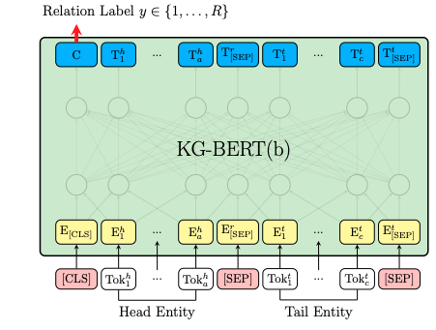
Method
adapt KG-BERT [Yao et al., 2019]
originally, it has been applied to:
link prediction
relation classification
triple classification
input is a description or a label for <h>, <r>,< t>

Slide 7
Some Assumptions (that might not hold)
The subject and the object have exactly one correct synset in WordNet
The relation of HasProperty is exactly one of the 27 properties (synsets) listed in WebChild's property file

Slide 8
Relation Classification – Task definition
Task: Predict the relation of the triple, given the labels or the descriptions of the subject and the object. (Example: use the subject, “mandarin orange” and the object “orange” to predict relation “color”)
27 Unique Relations: wn:quality.n.1, wn:trait.n.1, wn:age.n.1, wn:color.n.1, wn:beauty.n.1, wn:shape.n.2, wn:size.n.1, wn:state.n.2, wn:weight.n.1, wn:emotion.n.1, wn:strength.n.1, wn:motion.n.4, wn:physical_property.n.1, wn:temperature.n.1, wn:feeling.n.1, wn:sensitivity.n.2, wn:tactile_property.n.1, wn:manner.n.1, wn:sound.n.1, wn:ability.n.1, wn:appearance.n.1, wn:sustainability.n.1, wn:personality.n.1, wn:taste_property.n.1, wn:disposition.n.4, wn:length.n.1, wn:structure.n.2

Slide 9
Relation Classification - Setup
Task: Predict the relation of the triple, given the labels or the descriptions of the subject and the object. (Example: use the subject, “mandarin orange” and the object “orange” to predict relation “color”)
Setup:
Use WebChild as train, development and test data.
Learn to predict the correct relation id (wn:color.n.01) given the descriptions of the node synsets (e.g., wn:mandarin.n.01 and wn:orange.a.01).
Use different baselines to make prediction and calculate the accuracy.
Analyze the results and pick the most reliable baseline to classify HasProperty edges in CSKG.

Slide 10
Relation Classification - Data
Task: Predict the relation of the triple, given the labels or the descriptions of the subject and the object. (Example: use the subject, “mandarin orange” and the object “orange” to predict relation “color”)
Setup:
Use WebChild as train, development and test data.
Learn to predict the correct relation id (wn:color.n.01) given the descriptions of the node synsets (e.g., wn:mandarin.n.01 and wn:orange.a.01).
Use different baselines to make prediction and calculate the accuracy.
Analyze the results and pick the most reliable baseline to classify HasProperty edges in CSKG.
Data sampling:
Randomly Choose 100k lines which from WebChild’s property subset.
Split to train-dev-test at 80%: 10%: 10% ratio
The number of triples without relations | 3673697
The number of triples with relation | 2836191
The number of unique entities | 48076
The number of unique relations | 27
The most frequent entity | "wn:new.a.1"
The most frequent relation | "wn:quality.n.1"

Slide 11
Data sampling
Data sampling:
Randomly Choose 100k lines which from WebChild’s property subset.
Split to train-dev-test at 80%: 10%: 10% ratio
then filter duplicates, edges with no candidates, and edges where the ground truth is not in the candidates
 | Total Line | Duplicate Line | Remaining Line
Train | 80000 | 22 | 79978
Dev | 10000 | 7 | 9993
Test | 10000 | 9 | 9991
 | Total Line | No Candidates
Train | 79978 | 49854
Dev | 9993 | 6206
Test | 9991 | 6153
 | Total Line | Ground Truth not in Candidates (Left) | Ground Truth not in Candidates (Right)
Train | 30124 | 3685 | 0
Dev | 3787 | 447 | 0
Test | 3838 | 508 | 0

Slide 12
Relation Classification-Baselines
Baselines:
Random Baseline:
Randomly choose one relation from 27 unique relations.
Frequency Baseline (MFS):
Choose the relation, “wn:quality.n.1”, which is most frequent on the training set.
Sentence Embedding Baseline:
1. For each triple, create a sentence by concatenating the labels of the node1+relation+node2 as label sentence.
2. For each relation candidate, take its relation definition (candidate sentence).
Example for wn:quality.n.1: an essential and distinguishing attribute of something or someone
3. Embed the label sentence and each candidate sentence by sentence-transformer-bert Baseline (STB) and sentence-transformer-RoBERTa Baseline (STR).
4. Compute the cosine similarity between label sentence and candidate sentence.
5. Pick the candidate with max similarity.

Slide 13
Relation Classification-Baselines
Kg-Bert: BERT-based neural network
Training time Input: definitions of the subject and the object synset
Training time Output: One of the 27 relation labels
Test Input: definitions of the subject and the object synset
Test Output: score for each of the 27 labels
Example:
wn:food.n.1-wn:quality.n.1-wn:expensive.a.1
any substance that can be metabolized by an animal to give energy and build tissue;
high in price or charging high prices;
Input
Model
Output

Slide 14
Relation Classification on WebChild - Results
WebChild:
Relation Prediction
Accuracy | MRS | MFS | STB | STR | STB II | STR II | Kg-Bert
Train | 3.75% | 38.30% | 10.44% | 11.58% | 7.33% | 7.95% | 99.94%
Dev | 3.86% | 38.70% | 11.21% | 11.17% | 7.47% | 8.35% | 99.39%
Test | 3.85% | 37.70% | 10.77% | 11.50% | 8.17% | 7.90% | 99.48%
STB and STB II:
If we have a triple: “Entity1, Relation1, Entity2”
The label sentence of STB is “Entity1 label, Relation label, Entity2 label”
The label sentence of STB II is “Entity1 definition, Relation label, Entity2 definition”
Findings:
Kg-Bert has the best performance

Slide 15
Relation Classification on CSKG
Application to CSKG:
CSKG Test Data: sample 100 /r/HasProperty edges for which we can find 2+ candidates for the subject and 1+ candidates for the object in NLTK Corpus--WordNet.
KG-BERT: As the CSKG nodes are lexical, disambiguate the subject and the object to their most-frequent sense as node id.
this is correct more often than not, but it is causing some errors
Combine KG-BERT’s prediction with the MFS prediction using different ratios.
Pick 100 edges to manually inspect whether the prediction is right.
Calculate the accuracy.
Annotate the incorrect edges manually to be able to compare to the other baselines.

Slide 16
Relation Classification on CSKG - Results
Alpha | Relation Accuracy
0 | 77%
0.1 | 74%
0.2 | 77%
0.3 | 77%
0.4 | 75%
0.5 | 77%
0.6 | 79%
0.7 | 78%
0.8 | 80%
0.9 | 78%
1 | 65%
Score(s) is the final score of a word s.
$α$ is ratio coefficient, to balance between:
$f(s)$ = the frequency rank of a candidate (1 for most frequent sense).
$Model\left(s\right)$ = KG-BERT score

Slide 17
Relation Classification on CSKG – Analysis of misclassified edges
The most frequent sense for a node is not always correct. Wrong node id can result in incorrect prediction.
Predicted Result Example: /c/en/glass, wn:temperature.n.1, /c/en/solid;
Sometimes the answer is not bad, but there is a better one.
/c/en/glass, wn:shape.n.2, /c/en/empty; (wn:state.n.2 or wn.quality.n.1 may be better)
Sometimes it is hard to determine the correct answer. (/c/en/curtains,wn:temperature.n.1,/c/en/dusty)
The 27 WebChild relations may not cover all cases (e.g., 6 - /r/HasProperty - six).
Rest: the model is wrong.
(Most Frequency sense)
(Second most Frequency sense)

Slide 18
Relation Classification – Findings, challenges, future work
Incorrect disambiguation of nodes with MFS
Way forward: Combine node resolution and relation classification into a joint model.
Generation of ground truth in CSKG is time consuming
Way forward: Find/generate a CSKG test set.
KG-BERT scores suspiciously high on WebChild, but only about 80% on CSKG
The baselines score very low.
Options for joint prediction
message passing – would require additional constraints
multi-task prediction – might reduce generalizability

Slide 19
Node Resolution

Slide 20
Node Resolution - Introduction
Task: Predict the subject of the triple, given its relation and object.
Steps:
Use WordNet as training data.
Predict the correct subject id (wn:tendinitis.a.01) by the node and relation id (e.g., wn:inflammation.n.01 and /r/IsA).
Use different baselines to make prediction and calculate the accuracy.
Analyse the results and pick the most reliable baseline to classify nodes in CSKG.
In the step of CSKG prediction, disambiguate the object to their most-frequent sense as node id.
Pick 100 edges to manually inspect whether the prediction is right. And calculate the accuracy.

Slide 21
Node Resolution-Data Summary
WordNet:
The number of triples without relations | 0
The number of triples with relation | 111,276
The number of unique entities | 15,052
The number of unique relations | 3
The most frequent entity | "wn:bird_genus.n.01"
The most frequent relation | "/r/IsA"
WordNet Train, Dev, Test:
Randomly Choose 10k lines which has relation in triple from WordNet.
Divide the data at ratio 0.8: 0.1: 0.1.
Then remove duplicates, cases with no candidates, and cases with no ground truth in the candidates
CSKG:
Same 100 edges as in Relation Prediction

Slide 22
Node Resolution - Baselines
Candidates Generation: Candidates are the all subjects and objects in train dataset.
Example: albanian, /r/PartOf, albania (subject prediction)
albanian.n.01
Get synsets with lemma “albanian” from WordNet.
albanian
albanian.n.02
albanian.a.01
Baselines:
Random Baseline:
Randomly choose one candidate as the prediction result. (One of albanian.n.01, albanian.n.02, and albanian.a.01 )
Frequency Baseline (MFS):
Candidates are the same as Random Baseline. Choose the most frequent sense (albanian.n.01 in example).

Slide 23
Node Resolution-Baselines
Sentence Embedding Baseline:
Candidates are the same as previous baseline. For each triple, create a sentence by “node1;label+relation+node2;label” as label sentence.
Then for each subject candidate, create a sentence by subject definition as candidate sentence.
Use STB and STR model to transfer sentences to different sentence embedding. Compute the cosine similarity between label sentence and candidate sentence.
Pick the candidate whose sentence has the largest similarity.
Example: albanian, /r/PartOf, albania (subject prediction)
label sentence:
albanian part of albania
Candidate sentence:
albanian.n.01: a native or inhabitant of Albania
albanian.n.02: the Indo-European language spoken by the people of Albania
albanian.a.01: of or relating to Albania or its people or language or culture

Slide 24
Node Resolution – KG-BERT
Negative sampling: For each ground truth, we need to add some false label data.
V1: Randomly choose some subjects in the whole data file to replace the correct subject.
V2: Use other concurrent synsets that share the lemma.
Training Input: Build a sentence embedding from the definition of subject and object as input data. Relation id is 0 for false, 1 for true.
Training Output: A Classification Model with the score for triples
Test Input: Build all sentence embedding from the definition of all subject candidates from NLTK WordNet Corpus and object as input data
Test Output: Scores for all input triples. Pick the subject synset who has the highest score.
Example: albanian, /r/PartOf, albania (subject prediction)
albanian.n.01, /r/PartOf, albania
Model
albanian.n.01: 3.58
albanian, /r/PartOf, albania
albanian.n.02, /r/PartOf, albania
Model
albanian.n.02: -0.01
albanian.a.01, /r/PartOf, albania
Model
albanian.n.01: -0.33

Slide 25
Node Resolution – KG-BERT variants
Kg-Bert and Kg-Bert II:
The difference between Kg-Bert and Kg-Bert II is in the negative sampling
albanian.n.01, /r/PartOf, Albania; label: 1
Kg-Bert Model
albanian, /r/PartOf, albania
airhead.n.02, /r/PartOf, albania ; label: 0
Kg-Bert Model
dullness.n.02, /r/PartOf, albania ; label: 0
Kg-Bert Model
albanian.n.01, /r/PartOf, albania ; label: 1
Kg-Bert II Model
albanian, /r/PartOf, albania
albanian.n.02, /r/PartOf, albania ; label: 0
Kg-Bert II Model
albanian.a.01, /r/PartOf, albania ; label: 0
Kg-Bert II Model

Slide 26
Node Resolution-Result & Finding
WordNet:
Findings:
Kg-Bert has the best performance on WordNet
In WordNet, 58% of the subjects has only one candidate.
MFS has the best performance on WebChild. However, WebChild dataset is obtained by MFS method. Therefore, we still apply KG-BERT on CSKG.
Link Prediction
Dataset Type | Location | Baseline Type
 |  | MRS | MFS | STB | STR | Kg-Bert | Kg-Bert II
Train | Left Entity | 70.7% | 73.2% | 79.7% | 80.7% | 88.3% | 91.2%
 | Right Entity | 58.5% | 72.3% | 63.3% | 62.3% | 79.1% | 81.3%
Dev | Left Entity | 71.3% | 73.3% | 81.0% | 83.0% | 84.5% | 85.6%
 | Right Entity | 58.6% | 72.6% | 62.9% | 64.9% | 76.3% | 77.5%
Test | Left Entity | 71.4% | 73.2% | 81.3% | 85.2% | 85.9% | 86.9%
 | Right Entity | 59.6% | 72.6% | 64.8% | 67.1% | 74.9% | 77.9%
WebChild:
Link Prediction
Dataset Type | Location | Baseline Type
 |  | MRS | MFS | STB | STR | Kg-Bert
Train | Left Entity | 37.8% | 65.6% | 40.3% | 41.3% | 54.7%
 | Right Entity | 28.6% | 46.4% | 31.1% | 32.2% | 41.3%
Dev | Left Entity | 39.2% | 66.3% | 42.3% | 43.7% | 55.2%
 | Right Entity | 29.2% | 46.3% | 32.1% | 31.2% | 39.7%
Test | Left Entity | 37.9% | 65.0% | 42.1% | 41.9% | 53.9%
 | Right Entity | 29.1% | 47.6% | 33.2% | 34.3% | 41.0%
*: left entity accuracy of this baseline means the total accuracy

Slide 27
Node Resolution – CSKG Results
Findings:
Prediction is sometimes unstable Example: for “mandarin orange”
Alpha | Subject Accuracy | Object Accuracy
0 | 0.38 | 0.39
0.1 | 0.4 | 0.39
0.2 | 0.42 | 0.42
0.3 | 0.4 | 0.41
0.4 | 0.48 | 0.4
0.5 | 0.47 | 0.49
0.6 | 0.52 | 0.45
0.7 | 0.64 | 0.49
0.8 | 0.71 | 0.52
0.9 | 0.73 | 0.5
1 | 0.7 | 0.49
Alpha | Subject Accuracy | Object Accuracy
0 | 0.4 | 0.3
0.1 | 0.37 | 0.34
0.2 | 0.52 | 0.36
0.3 | 0.53 | 0.4
0.4 | 0.64 | 0.43
0.5 | 0.65 | 0.49
0.6 | 0.70 | 0.49
0.7 | 0.70 | 0.50
0.8 | 0.70 | 0.49
0.9 | 0.70 | 0.49
1 | 0.70 | 0.49
mandarin orange (two candidates):
mandarin_orange.n.01:
shrub or small tree having flattened globose fruit with very sweet aromatic pulp and thin yellow-orange to flame-orange rind that is loose and easily removed; native to southeastern Asia
mandarin_orange.n.02:
a somewhat flat reddish-orange loose skinned citrus of China
WordNet WebChild

Slide 28
Node Classification – Error analysis
For ambiguous subject/object, we pick the most frequent sense. However, most frequent is not always correct. Wrong node id can result in incorrect prediction.
Predicted Result Example: wn:yield.n.03, /r/HasProperty, /c/en/sour, fruit, sour;
wn:yield.n.03: an amount of a product
Sometimes it is hard to determine the correct answer. (/c/en/chip, /r/HasProperty,/c/en/dead)
Rest: model is wrong. Sometimes we find a reasonable one but not the best.
Predicted Result Example: wn:hair.n.03, /r/HasProperty, /c/en/thin;
hair.n.03: filamentous hairlike growth on a plant
(Most Frequency sense)
(Second most Frequency sense)

Slide 29
Node Resolution-Challenges & Ongoing Work
Challenges:
Unclear why the MFS results are better than KG-BERT alone on CSKG.
way forward: further analysis
Incorrect disambiguation of nodes with MFS
Way forward: Combine node resolution and relation classification into a joint model.
Generation of ground truth in CSKG is time consuming
Way forward: Find/generate a CSKG test set.
Hard to pick the best node when two candidates have similar classification scores.
Many subjects/objects have no obvious candidates in WordNet

Slide 30
Update: Feb 4th
FILIP ILIEVSKI;
Hanzhi Zhang;

Slide 31
Node Resolution-Subject vs object accuracy?
WordNet:
We saw that subjects are easier to disambiguate than objects.
Q: Is this correlated with the number of candidates?
Link Prediction
Dataset Type | Entity | Baseline Type
 |  | MRS | MFS | STB | STR | Kg-Bert | Kg-Bert II
Train | Subject | 70.7% | 73.2% | 79.7% | 80.7% | 88.3% | 91.2%
 | Object | 58.5% | 72.3% | 63.3% | 62.3% | 79.1% | 81.3%
Dev | Subject | 71.3% | 73.3% | 81.0% | 83.0% | 84.5% | 85.6%
 | Object | 58.6% | 72.6% | 62.9% | 64.9% | 76.3% | 77.5%
Test | Subject | 71.4% | 73.2% | 81.3% | 85.2% | 85.9% | 86.9%
 | Object | 59.6% | 72.6% | 64.8% | 67.1% | 74.9% | 77.9%
WebChild:
Link Prediction
Dataset Type | Entity | Baseline Type
 |  | MRS | MFS | STB | STR | Kg-Bert
Train | Subject | 37.8% | 65.6% | 40.3% | 41.3% | 54.7%
 | Object | 28.6% | 46.4% | 31.1% | 32.2% | 41.3%
Dev | Subject | 39.2% | 66.3% | 42.3% | 43.7% | 55.2%
 | Object | 29.2% | 46.3% | 32.1% | 31.2% | 39.7%
Test | Subject | 37.9% | 65.0% | 42.1% | 41.9% | 53.9%
 | Object | 29.1% | 47.6% | 33.2% | 34.3% | 41.0%

Slide 32
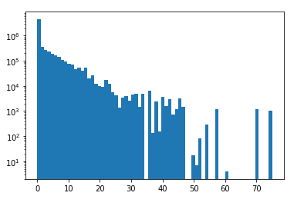
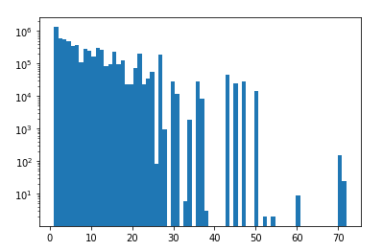
Node Resolution-Subject vs object candidates
Subjects have less candidates
No object lemmas have zero candidates, while many subjects have zero candidates
Edges with no subject candidates have more object candidates (not sure why this is)
 | Avg No. Candidates | Avg No. Candidates (c(s)>0 and c(o)>0) | Avg No. Candidates (c(s)==0 or c(o)==0)
Subject | 2.5 | 5.8 | 0.0
Object | 9.2 | 6.7 | 11.2

Slide 33
WebChild MFS based on training data frequency
MFS based on the WebChild training data performs better than WN MFS on WebChild. But on CSKG???
 | Accuracy (With 0) | Accuracy (Without 0) | Accuracy (Having correct answer)
Left Head | 35.02% | 81.15% | 89.37%
Right Head | 91.01% | 87.32% | 87.24%
 | WN MFS Accuracy | WC MFS Accuracy
Left Head | 70% | 63%
Right Head | 49% | 59%
MFS Baseline on WebChild
MFS Baseline on CSKG

Slide 34
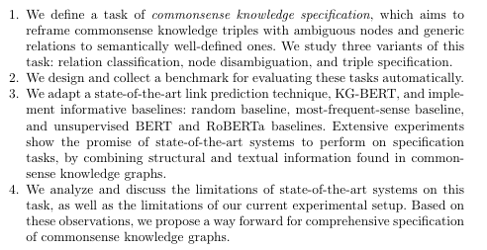
Possible contributions

Slide 35
1.Task
Node disambiguation and relation classification are ok
though in practice we evaluate on a single property class
we evaluate on nodes for which we can find candidates easily
We haven’t defined/tried the triple classification yet

Slide 36
2.Data for training and evaluation
We train on WebChild-prop and WordNet
WebChild not ideal for training node resolution
WordNet not useful for property classification
We test on 100 examples from CSKG
too small and ad-hoc – how to expand to a proper systematic benchmark?

Slide 37
3. Evaluation - setup
various baselines, unsupervised transformers, and KG-BERT
maybe another system should be added later
KG-BERT relies on sentences, which are originally from WordNet
how to generate sentences for arbitrary nodes?

Slide 38
3. Evaluation
Relation classification
Supervision with KG-BERT performs best on the source corpus (WebChild)
KG-BERT+MFS best on the test corpus, but performance drops 20%
Node disambiguation
on WordNet, KG-BERT || performs best on the source corpus
WebChild – best performance by MFS (artifact of the data)
On CSKG for both datasets, best performance with 90%MFS + 10% KG-BERT
max performance 73% when training on WN
subject performance much higher, partially because subjects have less candidates

Slide 39
4. Discussion and limitations
not urgent

Slide 40
Current obstacles
How to create a good benchmark for testing?
How to increase the set of properties?
How to deal with more complex node phrases (for which we get no candidates at first)?
how to generate sentences for arbitrary nodes?
Is triple classification needed?

Slide 41
Direction 2: Spatial knowledge about household items
How much spatial and part-whole knowledge about household items do we find in CSKG?
Method:
filter CSKG nodes based on a set of ~50 labels in the EQA
filter CSKG edges based on dimensions
Compute statistics

Slide 42
Statistics
Source | Number
VG | 3,446
CN | 265
CN|WN | 9
WD | 14
Number Edges: 3,734

Slide 43
cup | 406
mirror | 284
vase | 240
bed | 229
toilet | 223
computer | 191
sink | 166
desk | 160
pan | 148
television | 122
microwave | 101
refrigerator | 97
rug | 93
fireplace | 71
bathtub | 69
plates | 65
shower | 63
sofa | 54
dresser | 53
bookshelf | 50
kettle | 45
heater | 41
piano | 41
ottoman | 40
cutting board | 35
dishwasher | 28
dryer | 22
towel rack | 17
washer | 15
fish tank | 10
food processor | 7
ironing board | 6
vacuum cleaner | 4
loudspeaker | 3
fruit bowl | 3
tv stand | 3
coffee machine | 2
whiteboard | 1
xbox | 1
shoe rack | 1
chessboard | 1
wardrobe cabinet | 0
knife rack | 0
range oven | 0
utensil holder | 0
dressing table | 0
playstation | 0
stereo set | 0
water dispenser | 0

Slide 44
Relation distribution

Slide 45
Data quality impressions

Slide 46
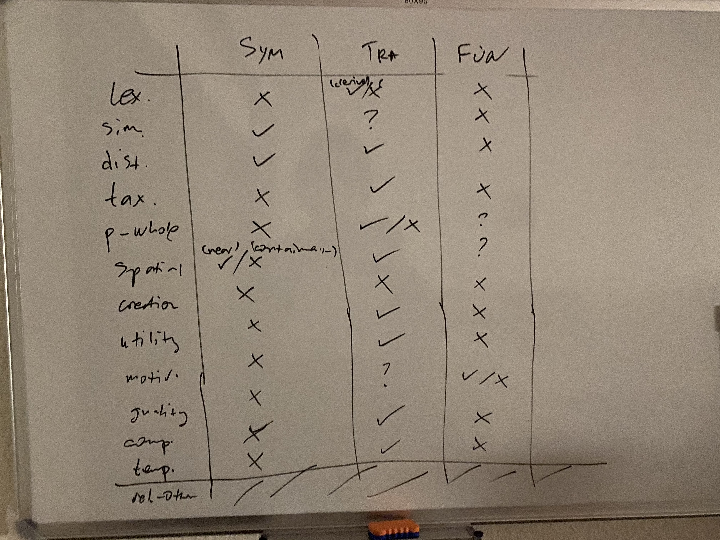
Direction 3: Constraint-based benchmark
Aspects like transitivity or symmetry have not been part of current benchmarks – is this something worth pursuing (by us)?

